Slide 1
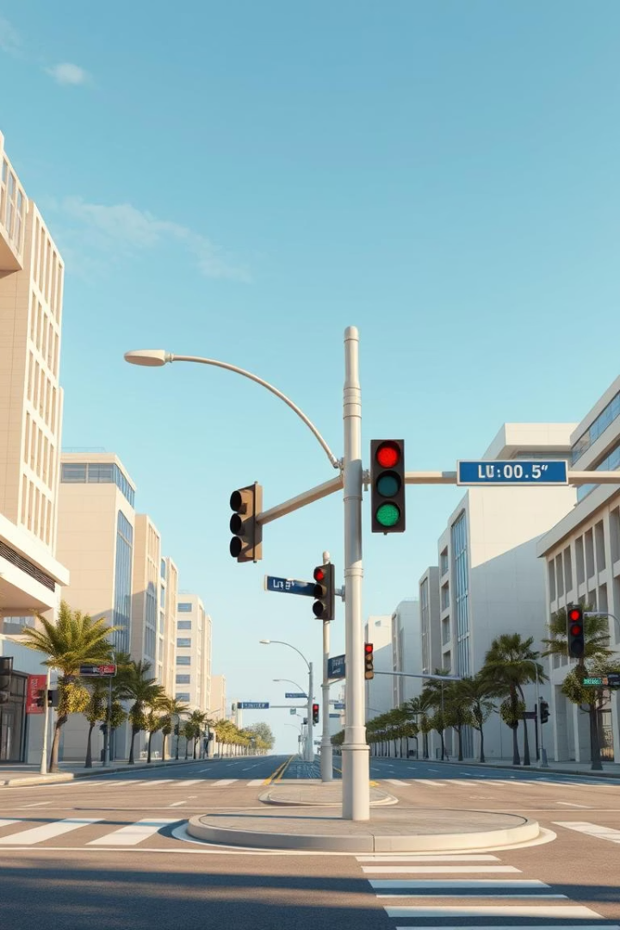
Traffic Light System:
Project Presentation
Presented by:
Muhammad Irtisam (06)
Muhammad Umer (05)
Course: COAL

Slide 2

Introduction to Traffic Light Systems
Simulates a traffic light system using 8086 Assembly Language in the EMU8086 emulator
Displays text-based colored signals: RED, YELLOW, and GREEN, each with countdown timers
Countdown shown beside each signal with 1-second updates using delay loops.
Beep sound added at each phase transition
Demonstrates screen clearing, colored messages, loop timing, interrupts, and register handling.

Slide 3
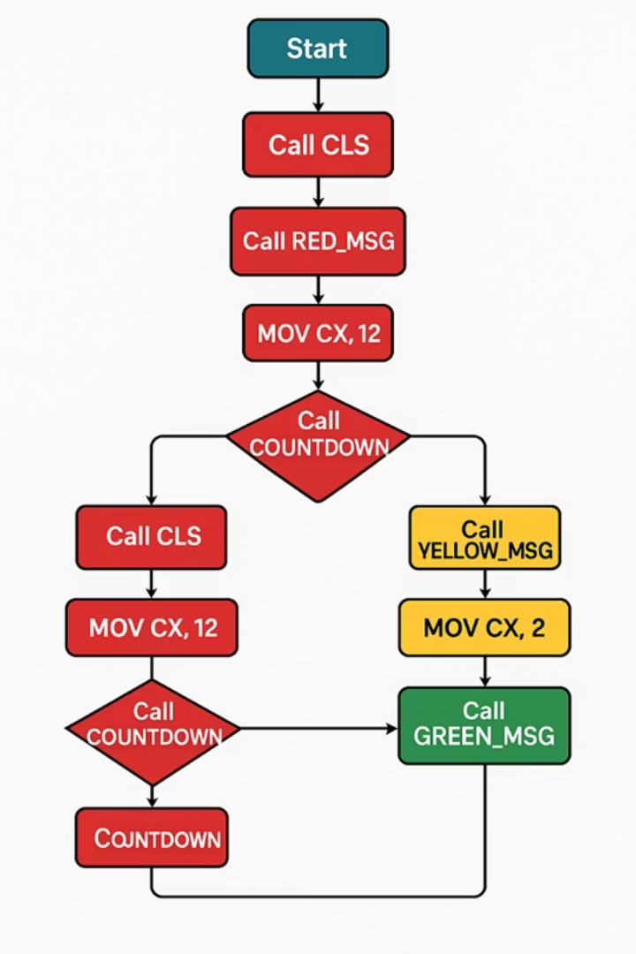
Methodology
Tool Used: EMU8086 emulator for real-time simulation and video memory interaction.
Problem Analysis: Mimicked real-world signal flow and assigned accurate time durations to each light.
Programming Approach:
Coded in 8086 Assembly using registers, loops, interrupts, and procedures.
Separate functions for each light phase, beep, countdown, and screen management.
Visual Design:
Used video memory segment B800h for colored text output.
Positioned messages using calculated screen offsets.
Countdown & Delay: Implemented using loops and subroutines that convert numbers to characters.
Testing & Debugging: Each module tested individually; then integrated into an infinite loop.
Final Version: Infinite loop with improved screen layout and timing accuracy.

Slide 4
RESULTS
Correct Phase Timing: Each light (Red, Yellow, Green) displayed for the correct duration.
Dynamic Countdown: Displayed in real-time with 1-second updates.
Visual Output:
RED = Stop, YELLOW = Wait, GREEN = Go
Text centered using offset logic and displayed in appropriate colors.
Audio Feedback: Beep sound at the start of each phase using BIOS interrupt.
Clean Transitions: Screen cleared between phases for clarity.
Infinite Loop: Simulation runs continuously like a real traffic signal system.

Slide 5
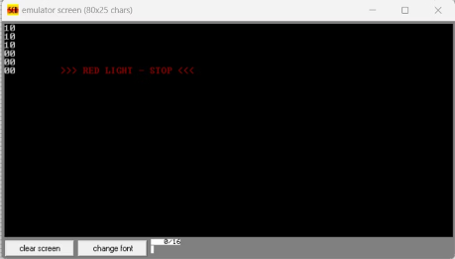
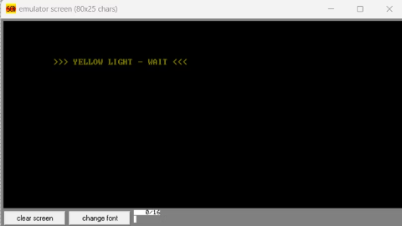
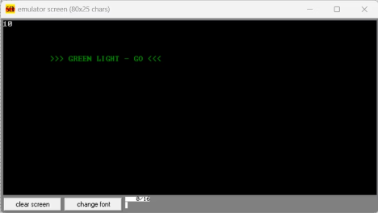
RESULTS

Slide 6

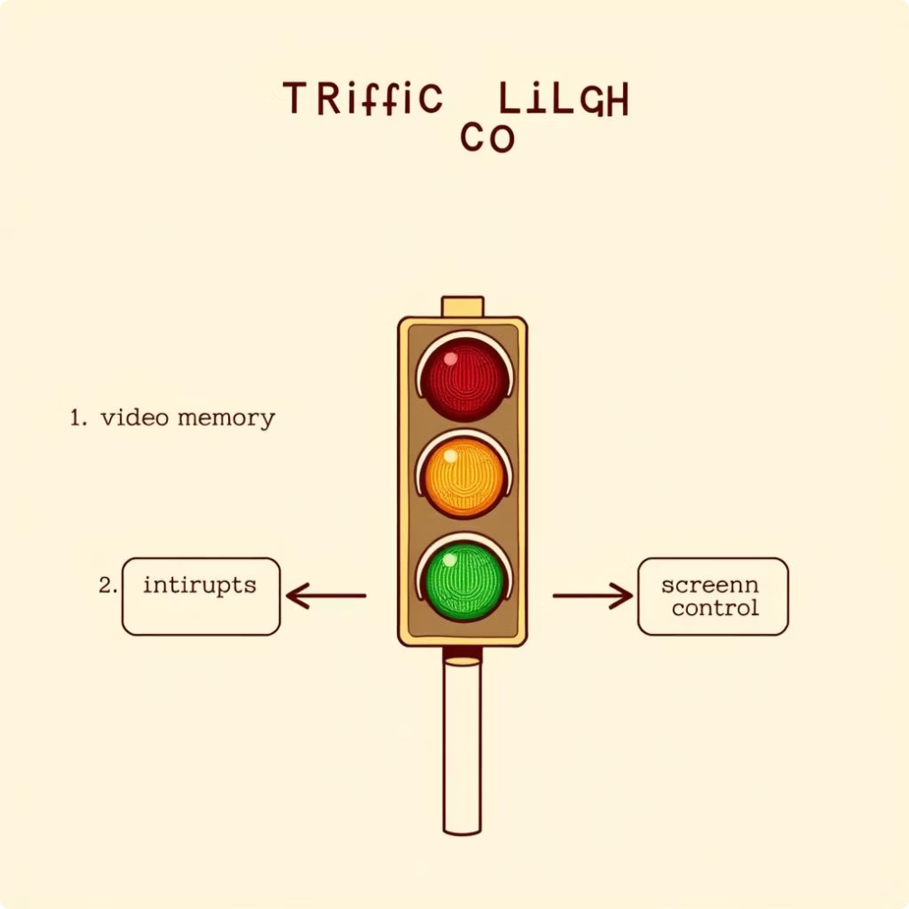
CONCLUSION
Successfully replicated a basic traffic light controller using Assembly Language.
Demonstrated use of video memory, interrupts, countdown logic, and screen control.
Useful for understanding embedded systems, low-level programming, and real-time logic.
Can be extended with:
Real-time clock integration
Vehicle/pedestrian sensors
GUI or graphical mode
Multiple intersections
Emergency overrides
Porting to high-level languages
Offers strong educational value and is easily customizable for future enhancements.

Slide 7

Thank you
The End

